Slide 1
Cyber bullying Detection on Social Networks Using Machine Learning Approaches
MOHAMMED LIJAS C
MES20MCA-2028
PRODUCT OWNER: MR VASUDEVAN T.V

Slide 2
TABLE OF CONTENTS
Introduction
Modules
Data Flow Diagram
Developing Environment
Product Backlog
User Stories
Project Plan
Sprint Plans
Sprint Actual

Slide 3
INTRODUCTION
Cyberbullying can be defined as aggressive, intentional actions performed by an individual or a group of people via digital communication methods such as sending messages and posting comments against a victim.
Different from traditional bullying that usually occurs at school during face-to-face communication, cyber bullying on social media can take place anywhere at any time.
Cyberbullying frequently leads to serious mental and physical distress, particularly for women and children, and even sometimes force them to attempt suicide.
The purpose of this project is to design and develop an effective technique to detect online abusive and bullying messages by merging natural language processing and machine learning. Two distinct features,namely Bag-of - Words and term frequency-inverse text frequency (TF-IDF)
In propsed system, we suggest a cyberbullying detection model based on machine learning that can detect whether a text relates to cyberbullying or not.
The results indicate that TF-IDF feature provides better accuracy than BoW. Users behaviour could be defined inseveral approaches like association rules in perspective of mining, complex graph activities, sequence mining etc.Suppose for two different user we have same behaviour we can recommend them each other.

Slide 4
METHODOLOGY
MACHINE LEARNING
Machine learning (ML) is the study of computer algorithms that can improve automatically through experience and by the use of data. It is seen as a part of artificial intelligence. Machine learning algorithms build a model based on sample data, known as training data, in order to make predictions or decisions without being explicitly programmed to do so. Machine learning algorithms are used in a wide variety of applications, such as in medicine, email filtering, speech recognition, and computer vision, where it is difficult or unfeasible to develop conventional algorithms to perform the needed tasks.
A subset of machine learning is closely related to computational statistics, which focuses on making predictions using computers; but not all machine learning is statistical learning. The study of mathematical optimization delivers methods, theory and application domains to the field of machine learning. Data mining is a related field of study, focusing on exploratory data analysis through unsupervised learning.

Slide 5
Term Frequency Inverse Document Frequency (TF IDF)
TF-IDF is frequently used in machine learning algorithms in various capacities, including stop-word removal. These are common words like “a, the, an, it” that occur frequently but hold little informational value. TF-IDF consists of two components, term frequency, and inverse document frequency
Term frequency can be determined by counting the number of occurrences of a term in a document.
IDF is calculated by dividing the total number of documents by the number of documents in the collection containing the term. It’s useful for reducing the weight of terms that are common within a collection of documents.

Slide 6
FUTURE ENHANCEMENT
Current system that i implemented have only text filtering and block those kind of
users.In Future i can implement image filtering which means those who post vulgar
Post in form photos,comments etc.. and those users can be blocked by admin

Slide 7
MODULES
ADMIN
1.View user
2.Add bullying words
3.Add good words
4.View bullying words
5.View good words
6.View report

Slide 8
USER
1.Registration
2.Add post
3.View my post
4.Chat
5.Add bullying words
6.Add friend request
7.View friend request
8.View recommendation

Slide 9
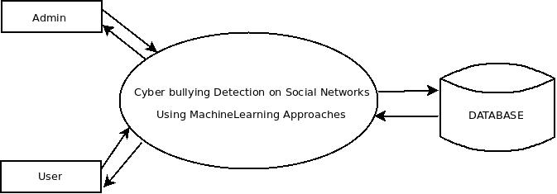
DATA FLOW DIAGRAM
LEVEL 0

Slide 10
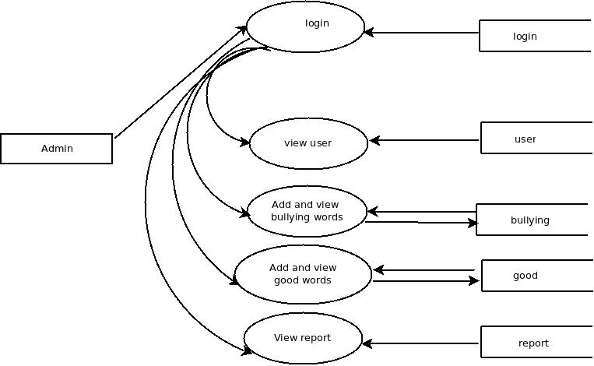
LEVEL 1.1

Slide 11
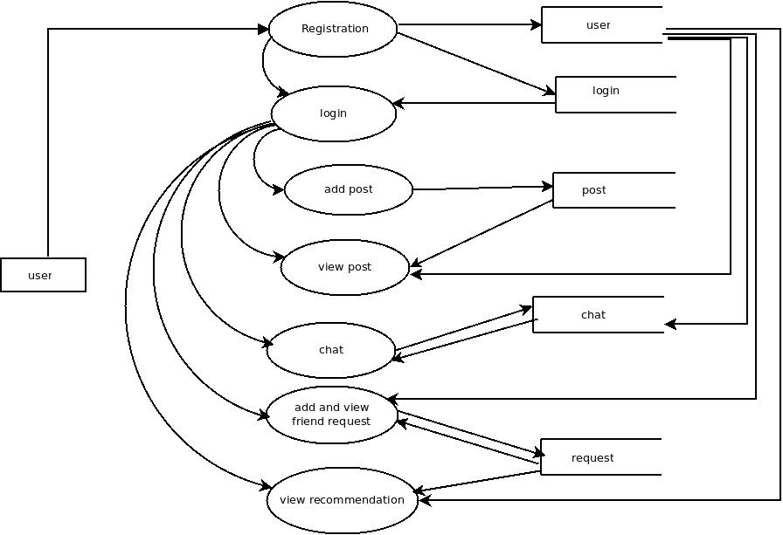
LEVEL 1.2

Slide 12
DEVELOPING ENVIRONMENT
Software Requirements
Operating System - Windows 7 or Above , Linux
Frontend – HTML,CSS,JavaScript
Backend – Python ,MySQL
Platform used - PyCharm, MySQL workbench
Web Browser - Google Chrome, Fire fox, Microsoft Edge
Frame work - Flask

Slide 13
PRODUCT BACKLOG
User Story ID | Priority <High/Medium/Low> | Size (Hours) | Sprint <#> | Status <Planned/In progress/Completed> | Release Date | Release Goal
1 | Medium | 2 | 1 | Completed | 08/01/2022 | Table design
2 | High | 3 |  | Completed | 08/01/2022 | Form design
3 | High | 5 |  | Completed | 08/01/2022 | Basic coding
4 | High | 5 | 2 | Completed | 16/01/2022 | Creation of data set
5 | Medium | 5 |  | Completed |  | Prediction
6 | High | 5 | 3 | Completed | 27/01/2022 | Filtering
7 | high | 5 |  | Completed |  | Machine learning
8 | Medium | 5 | 4 | Completed | 10/02/2022 | Testing data
9 | High | 5 |  | Completed | 19/02/2022 | Output generation
Notes:
<number>

Slide 14
USER STORIES
UserStoryID | As a <type of user> | I want to | So that I can
1 | Admin | login | login successful with correct username and password
2 | Admin | View users | View all user details
3 | Admin | Add and view bullying words | Add and manage bullying words
4 | Admin | Add and view good words | Add and manage good words for dataset
5 | Admin | View report | View reports about bullying posts
6 | User | Registration | Registration using personal information
7 | User | Add post | Add a new post to OSN
8 | User | View post | View all post OSN
9 | User | Add and manage friend request | Accept or reject friend request
10 | User | Chat | Chat with friends
11 | User | View recomendation | View recomendation

Slide 15
PROJECT PLAN
User Story ID | Task Name | Start Date | End Date | Days | Status
1 | Sprint 1 | 26/12/2021 | 28/12/2021 | 2 | Completed
2 |  | 29/12/2021 | 31/12/2021 | 3 | Completed
3 |  | 03/01/2022 | 08/01/2022 | 5 | Completed
4 | Sprint 2 | 09/01/2022 | 16/01/2022 | 8 | Completed
5 |  | 18/01/2022 | 22/01/2022 | 5 | Completed
6 | Sprint 3 | 23/01/2022 | 27/01/2022 | 5 | Completed
7 |  | 30/01/2022 | 05/02/2022 | 7 | Completed
8 | Sprint 4 | 06/02/2022 | 10/01/2022 | 5 | Completed
9 |  | 16/02/2022 | 19/02/2022 | 4 | Completed

Slide 16
SPRINT BACKLOG PLAN
Backlog Item | Status & completion date | Original estimate in hours | Day1 | Day2 | Day3 | Day4 | Day5 | Day6 | Day7 | Day8 | Day9 | Day10 | Day11 | Day12 | Day13 | Day14
User story #1,#2,#3 |  | hrs | hrs | hrs | hrs | hrs | hrs | hrs | hrs | hrs | hrs | hrs | hrs | hrs | hrs | hrs
Table design | 28/12/2021 | 2 | 1 | 1 | 0 | 0 | 0 | 0 | 0 | 0 | 0 | 0 | 0 | 0 | 0 | 0
Form design | 31/12/2021 | 3 | 0 | 0 | 0 | 1 | 1 | 1 | 0 | 0 | 0 | 0 | 0 | 0 | 0 | 0
Coding | 08/01/2021 | 5 | 0 | 0 | 0 | 0 | 0 | 0 | 0 | 0 | 0 | 1 | 1 | 1 | 1 | 1
User story #4,#5
Creation dataset | 16/01/2022 | 5 | 1 | 1 | 0 | 1 | 0 | 1 | 0 | 1 | 0 | 0 | 0 | 0 | 0 | 0
Preprocessing | 22/01/2022 | 5 | 0 | 0 | 0 | 0 | 0 | 0 | 0 | 0 | 0 | 1 | 1 | 1 | 1 | 1
User story #6,#7
Training | 27/01/2022 | 5 | 1 | 1 | 1 | 1 | 1 | 0 | 0 | 0 | 0 | 0 | 0 | 0 | 0 | 0
Prediction | 05/02/2022 | 5 | 0 | 0 | 0 | 0 | 0 | 0 | 0 | 1 | 0 | 1 | 1 | 1 | 0 | 1
User story #8,#9
Testing data | 10/02/2022 | 5 | 1 | 1 | 1 | 1 | 1 | 0 | 0 | 0 | 0 | 0 | 0 | 0 | 0 | 0
Output generation | 19/02/2022 | 5 | 0 | 0 | 0 | 0 | 0 | 0 | 0 | 0 | 0 | 2 | 1 | 1 | 1 | 1
Total |  | 40 | 4 | 4 | 2 | 4 | 3 | 2 | 0 | 2 | 0 | 5 | 4 | 4 | 3 | 4

Slide 17
SPRINT ACTUAL
Backlog Item | Status & completion date | Original estimate in hours | Day1 | Day2 | Day3 | Day4 | Day5 | Day6 | Day7 | Day8 | Day9 | Day10 | Day11 | Day12 | Day13 | Day14
User story #1,#2,#3 |  | hrs | hrs | hrs | hrs | hrs | hrs | hrs | hrs | hrs | hrs | hrs | hrs | hrs | hrs | hrs
Table design | 28/12/2021 | 2 | 1 | 1 | 0 | 0 | 0 | 0 | 0 | 0 | 0 | 0 | 0 | 0 | 0 | 0
Form design | 31/12/2021 | 3 | 0 | 0 | 0 | 1 | 1 | 1 | 0 | 0 | 0 | 0 | 0 | 0 | 0 | 0
Coding | 08/01/2021 | 5 | 0 | 0 | 0 | 0 | 0 | 0 | 0 | 0 | 0 | 1 | 1 | 1 | 1 | 1
User story #4,#5
Creation dataset | 16/01/2022 | 5 | 1 | 1 | 0 | 1 | 0 | 1 | 0 | 1 | 0 | 0 | 0 | 0 | 0 | 0
Preprocessing | 22/01/2022 | 5 | 0 | 0 | 0 | 0 | 0 | 0 | 0 | 0 | 0 | 1 | 1 | 1 | 1 | 1
User story #6,#7
Training | 27/01/2022 | 5 | 1 | 1 | 1 | 1 | 1 | 0 | 0 | 0 | 0 | 0 | 0 | 0 | 0 | 0
Prediction | 05/02/2022 | 5 | 0 | 0 | 0 | 0 | 0 | 0 | 0 | 1 | 0 | 1 | 1 | 1 | 0 | 1
User story #8,#9
Testing data | 10/02/2022 | 5 | 1 | 1 | 1 | 1 | 1 | 0 | 0 | 0 | 0 | 0 | 0 | 0 | 0 | 0
Output generation | 19/02/2022 | 5 | 0 | 0 | 0 | 0 | 0 | 0 | 0 | 0 | 0 | 2 | 1 | 1 | 1 | 1
Total |  | 40 | 4 | 4 | 2 | 4 | 3 | 2 | 0 | 2 | 0 | 5 | 4 | 4 | 3 | 4

Slide 18
THANK YOU

